Slide 1
V116 Simulation Requirements

Slide 2










Overview
In simple terms, Agent based Modeling and Simulation can be thought of as creating a virtual world where individual agents, representing entities such as people, animals, or even ideas, interact with each other and their surroundings.
Think of it like building a flight simulator for pilot training.
With Agent Based Modeling and Simulation in marketing, we can safely observe and analyze the outcomes of multiple marketing strategies without the risk and cost of implementing them in real life scenarios.
SCENARIO 1
SCENARIO 1, 2, 3, 4…
FAILED
SCENARIO 2
SCENARIO N
PASSED
THE OBJECTIVE IS TO LEVERAGE AGENT BASED COMPUTER SIMULATIONS TO ADDRESS THE MACRO AND MICRO FINANCIAL OUTCOMES OF VARIOUS MARKETING STRATEGIES WITHIN A GIVEN BRAND ENVIRONMENT
Notes:
Brand sales depends on groups of entities that operate in a dynamic market environment with complex interactions among them. Examples of the entities are HCPs, Consumers, Government Policies, Brand efficacy and safety, Managed Care etc.
Our objective here is simulate these behaviors virtually in a computer, so that a marketer can observe the estimated sales trends arising from different marketing strategies applied within the dynamic environment. The learnings help to fine tune the marketing strategies at both macro and micro levels.

Slide 3
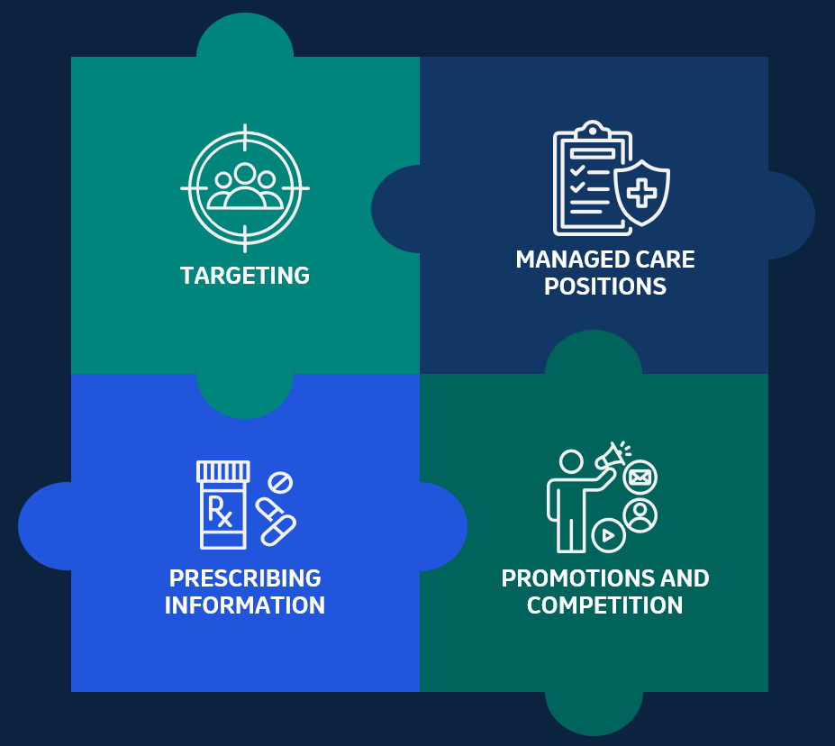
Opportunity
Controllable Internal
A brand’s sales is impacted by multiple factors.
While certain factors such as targeting and managed care positions can be controlled by a company, other elements like prescribing information and the impact of promotions/competition are beyond their direct control.
Estimating sales impact by these factors and the interactions between them will help in developing effective marketing strategies.
Non Controllable External
Notes:
Let us consider an example.
A brand’s market environment and its sales are impacted by multiple factors such as a) HCP and Consumer Targets b) Formulary Positions c) Brand Efficacy & Prescribing Information (PI) d) HCP and Consumer Promotions e) Competition etc.
Currently, we study and model the impacts of such factors on resulting sales independently by respective teams of experts. The interactions are not completely captured.
In reality, these factors depend on each other and a complex interaction among them defines the market environment and the resulting sales.
A clear opportunity exists to study sales trends and develop effective marketing strategies through analytical models that would incorporate such interactions along with individual factors.

Slide 4
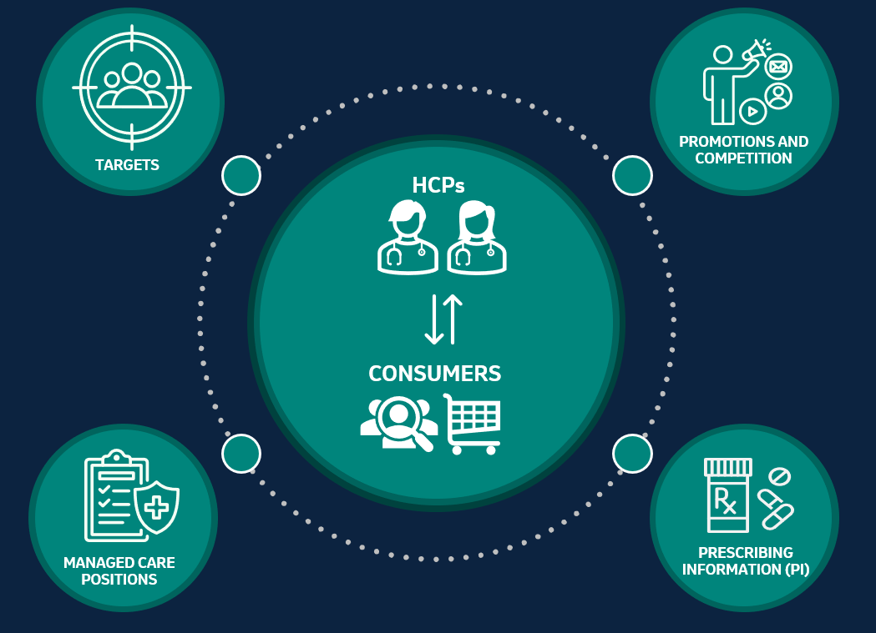
Solution – Agent Based Model
Computer based simulation of dynamic market environment of a brand can illuminate how complex marketing phenomena emerges from individual behaviors of various stakeholders
Agent Based Modeling is a simulation technique that mimics complex market environments and interactions between several factors.
Marketers can simulate multiple marketing strategies, study the sales outcomes, and select the most effective strategy to maximize sales!
Notes:
Agent Based Modeling is a simulation technique that could help in mimicking complex market environment.
Once modeled and validated, marketers then virtually simulate multiple marketing strategies and study the sales outcomes.
This enables the marketer to choose most effective strategy to maximize sales.
We start with creating thousands of virtual HCPs and Consumers.
Each HCP is assigned attributes such as Specialty, Group Practice, Geographic Location, Plans, Promotions, Targeting status etc. Consumer attributes such as age, gender, location, insurance plan, social network and promotions are assigned. Similarly, Brand profiles, Prescription policies, Managed Care plans, Competitions are defined as entities.
Then behaviors and interactions between them are specified and models are validated against available historical data.
We then simulate market dynamics of each week sequentially for say, up to one year.
During the process we summarize the brand sales trend at both national as well as defined sub-segments.

Slide 5
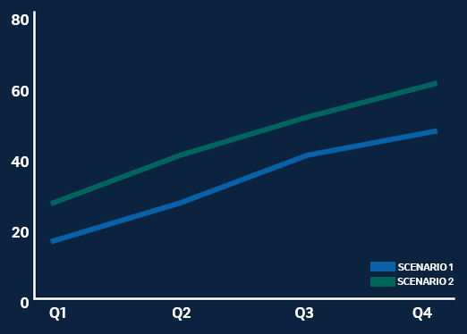
Outcomes – Agent Based Model
1
INPUTS
2
OUTPUT RESULTS: BRAND SALES TRENDS
SCENARIO 1
Spend: $X
SCENARIO 2
Spend: $1.4X
Top PCPs with a set of HCP Promotions
Top PCPs and Specialists with increased promotions
Consumers: Adult 50+ and a set of HCC Promotions
Consumers: Adult 50+ and a set of HCC Promotions
Commercial Plans:
Tier 2 Formulary: 20% Rx
Prior Authorization: 40% Rx
Commercial Plans:
Tier 2 Formulary: 35% Rx
Prior Authorization: 35% Rx
Heavy Competition
Heavy Competition
Spend is 40% more due to higher discounts and promotions, but estimated yearly sales for Scenario 2 is 25% more than first.
3
Conclusion: Considering future growth potential, Scenario 2 is preferred even though the spend is higher now.
Notes:
A marketer can run different scenarios and observe resulting sales. Here are two example scenarios:
Scenario 1:
Target top PCPs with a set of HCP promotions. Consumers who are Adults 50+ of age are targeted by set of Consumer promotions. 20% of commercial plans have preferred formulary position and 40% of plans need prior authorization. Competing brand is heavily promoted.
Scenario 2:
Scenario 1 with following changes - HCP targets are group practices with top Specialists and PCPs. 35% of commercial plans have preferred formulary position and another 35% of plans require prior authorization.
Estimate the sales trend during first year of launch from these two scenarios.
Results: Estimated yearly sales for second scenario is 25% more than first. Additional spend is about 40% more in terms of discount rates and promotions.
Conclusion: Considering future growth potential, scenario B is preferred even though the spend is higher now.

Slide 6
V116 REQUIREMENTS

Slide 7
Introduction
This part is meant for collecting information needed for simulating virtual market conditions for V116.
SECTION 1: GENERAL INFORMATION - General Information about the product
SECTION 2: PLAYERS (ENTITIES) Various entities or players in the brand market. For each entity we collect information about their characteristics, functions and both controllable and uncontrollable options available for marketers. This tab can also have descriptions of multiple segments of the entity.
SECTION 3: INTERACTIONS - Overall interactions and flows between the players, that is the overall market environment. It contains description of the flow of events, market conditions, and both controllable and uncontrollable options available for marketers.
SECTION 4: SCENARIOS - The scenarios that the marketers wish to study.

Slide 8
SECTION 1 – GENERAL INFORMATION

Slide 9
SECTION 1 – GENERAL INFORMATION
Add general Information about the product. For example:
1. Therapeutic Area

Slide 10
SECTION 2 - PLAYERS

Slide 11
PLAYERS – Approving Agency (ACIP) Details
Description of Approving Agency (ACIP) and its role regarding V116
Choices available for the Approving Agency that could be influenced by Merck (if any)
Choices available for the Approving Agency but Merck cannot influence

Slide 12
PLAYERS – Brand Profile and PI
Description of brand (efficacy, safety, prescribing information etc)
Choices available that could be influenced by Merck (if any)
Choices available but Merck cannot influence

Slide 13
PLAYERS – Consumer/Patient Details
Description of consumers and patients who may or may not prefer V116 (i.e., age, gender, income levels, prior vaccines, geography, perceptions on v116 and competition, who influences them, any social networks that could influence more, etc)
Choices available that could be influenced by Merck (if any)
Choices available but Merck cannot influence

Slide 14
PLAYERS – Managed Care Details
Formulary positions, % population reached and any details about managed care influence on prescriptions
Choices available that could be influenced by Merck (if any)
Choices available but Merck cannot influence

Slide 15
PLAYERS – Pharmacist Details
Description of Pharmacist who would prescribe V116 (i.e., chain, influenced by, special training, perception of competition etc)
Choices available that could be influenced by Merck (if any)
Choices available but Merck cannot influence

Slide 16
PLAYERS – Physician Details
Description of various physicians who would prescribe V116 (i.e., specialty, special training, perception of competition etc)
Choices available that could be influenced by Merck (if any)
Choices available but Merck cannot influence

Slide 17
PLAYERS – Promotions – HCP/HCC Details
HCP promotions: planned or available promotions to Physicians and Pharmacists along with reach / frequency (if available) and channels. General spend levels for different promotions (if any available)
HCP Promotion Choices available that could be influenced by Merck (if any)
HCP Promotion Choices available but Merck cannot influence
HCC promotions: planned or available promotions to Consumers along with reach / frequency (if available) and channels. General spend levels for different promotions (if any available)
HCC Promotion Choices available that could be influenced by Merck (if any)
HCC Promotion Choices available but Merck cannot influence

Slide 18
PLAYERS – Targeting Details
Profiles of targeted HCPs and general methods of reaching them
Profiles of targeted Consumers and general methods of reaching them
Choices available that could be influenced by Merck (if any)
Choices available but Merck cannot influence

Slide 19
SECTION 3 - INTERACTIONS

Slide 20
INTERACTIONS – Flow of Events
Describe in general the interactions between different players.
For example:
V116 gets approval on day X. Approval has XYZ as prescribing standards or constraints.
On a given day, physician see X (if available) appropriate patients and prescribes V116 for a fraction of them. The patients gets the vaccines at the physician office OR patients can take the Rx to pharmacies to get vaccinated.
In a parallel track, pharmacists can vaccinates around Y (if available) patients per day with V116.
Promotions starts on day Y
Patients can ask for V116 directly and physician or pharmacist X% (if available) of time honor the vaccination request.
Any notes on competition and how physician and/or pharmacists make the decision between our brand and competition.
Any supply constraints?
Any formulary constraints?

Slide 21
SECTION 4 - SCENARIOS

Slide 22
SCENARIOS – Scenarios to Study

